Slide 1
Issues in TerrSet's Land Change Modeler: Report to Clark Lab
GEOG 360-01-F23
Adeline Akansobe (aakansobe@clarku.edu),
Yu-Yun Ruan (yruan@clarku.edu),
Clio Bate (cbate@clarku.edu),
Esha Bharadwaj (ebharadwaj@clarku.edu)
December 20th, 2023

Slide 2
Table of Contents
Research Objective................................3
Data and Preparation.............................4
Study Area..........................................5
Calibration Intervals...........................6
Variables.............................................7
Runs – methodology and results
Run A: LR, DTC_{D}..................................9
Run B: LR, DTA_{S}, DTP_{D} ......................12
Run C: LR DTC_{D}, slope_{S}, elevation_{S},
with zoning...........................................16
Run D: MLP, DTC_{D} …..........................18
Run E: MLP, DTC_{S} , DTA_{S}, DTP_{D}...........21
Additional Runs....................................25
Summary of Findings............................28

Slide 3
Research Objective
The objective of our research was to simulate gross gains and losses and attempt to simulate alternations for the time interval of 2000 to 2020 using temporary crop data from Bahia, Brazil in TerrSet’s Land Change Modeler (LCM). In this research, we use two sub-models: Logistic Regression(LR) and Multi-Layer-Perceptron (MLP). This project was conducted as a final project for GEGO360 Land Change Modeling with Professor Gil Pontius.
These slides serve as our final product, a report to Clark Labs on the software issues encountered during the analysis, including striping/banding, masking, and other errors.
We used TerrSet Version: 19.0.6 (MSGIS lab computer) and 19.0.8

Slide 4
Data and Preparation
File Name | Type | Resolution | Description
reclass_9_municipalities | Raster | 120m | The mask of the study area which includes nine municipalties: Formosa do Ro Preto, Riachao das Neves, Barreiras, Luis Eduardo Magahles, Sae Desderio, Santa Maria da Vitoria, Correntinam, Jaborandi, and Cocos.
bahia temporary crops_1990_120m | Raster | 120m | Shows the distribution of presence and absence of temporary crop in 1990.
bahia temporary crops_2000_120m | Raster | 120m | Shows the distribution of presence and absence of temporary crop in 2000.
bahia temporary crops_2010_120m | Raster | 120m | Shows the distribution of presence and absence of temporary crop in 2010.
bahia temporary crops_2020_120m | Raster | 120m | Shows the distribution of presence and absence of temporary crop in 2020.
change_distance | Raster | 120m | Shows the Distance to change (made from 1990 and 2000 temporary crop image, using crosstab, then reclass change as 1, stable presence and absence as 0, apply Distance for the reclass result) in meters within the study area.
distance_to_presence | Raster | 120m | Shows the distance to presence of temporary crop in meters within the study area in 1990. This is the variable we used in our runs
distance_to_absence | Raster | 120m | Shows the distance to absence of crop in meters within the study area in 1990. -This is the one we used in our runs.
Dist_presence_untested | Raster | 120m | Shows the distance to presence of in meters within the study area in 1990 - Untested
Dist_absence_untested | Raster | 120m | Shows the distance to absence of in meters within the study area in 1990 - Untested
elevation_120 | Raster | 120m | Shows the elevation in meters within the study area.
slope_120 | Raster | 120m | Shows the slope within the study area.
Notes:
All of this data is in a folder called data_120m.
A folder called, data_120_masked has the same variables but masked (not including reclass of municipalities, and the untested variables)

Slide 5
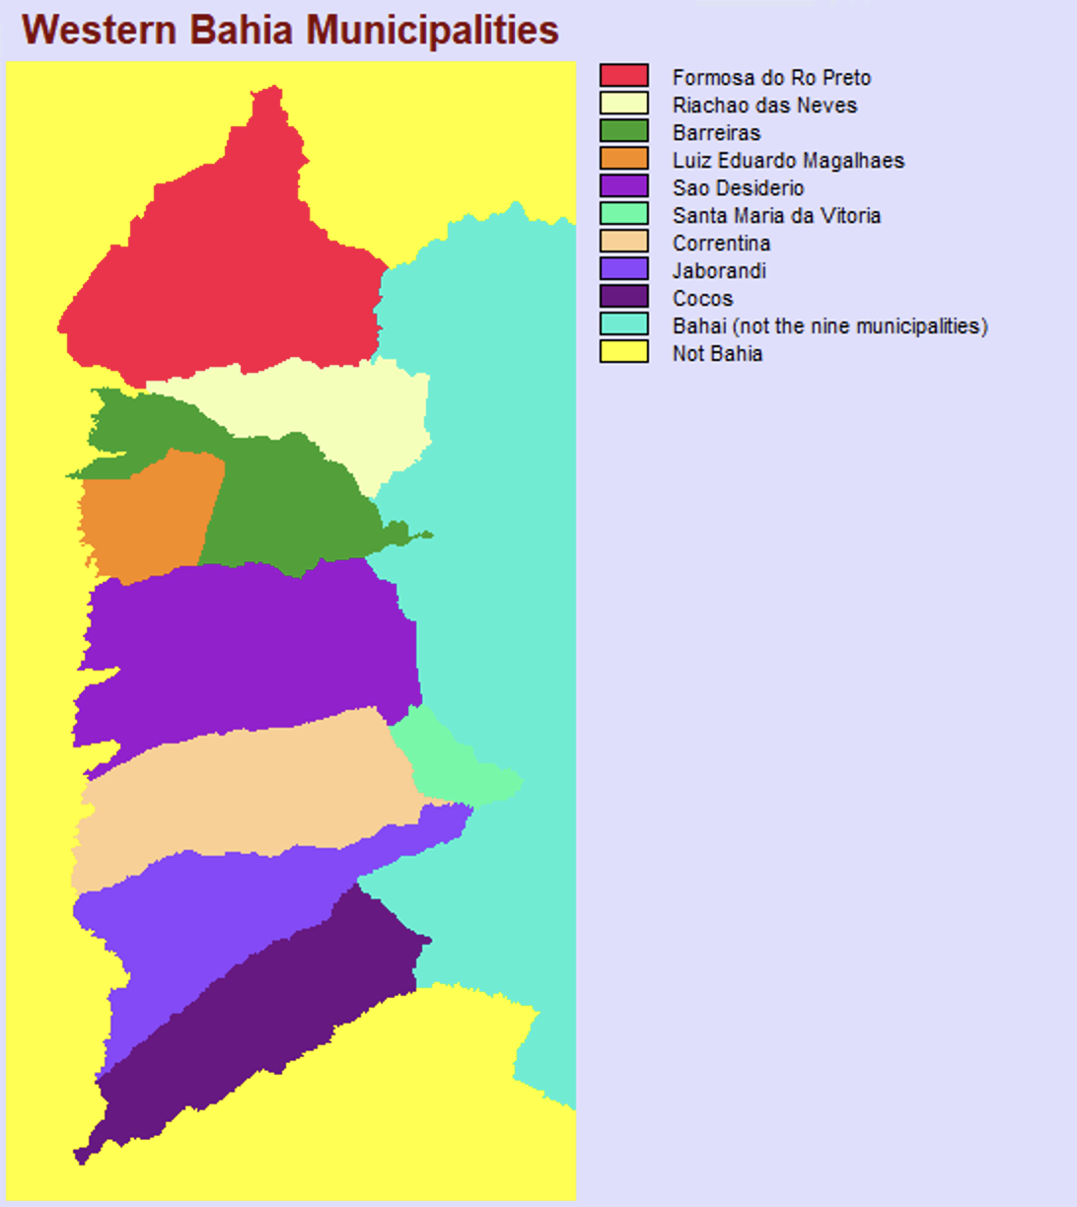
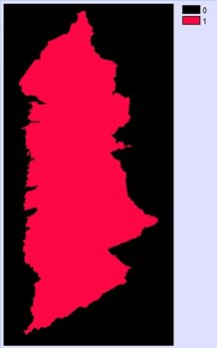
Data and Preparation - Study Area: Bahia Brazil
We masked Bahia's nine municipalities to ensure all simulated change would occur within the study area.
Figure 1. Western Bahia Municipalities
Figure 2. The study area (in red)

Slide 6
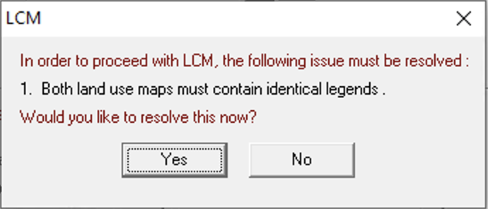
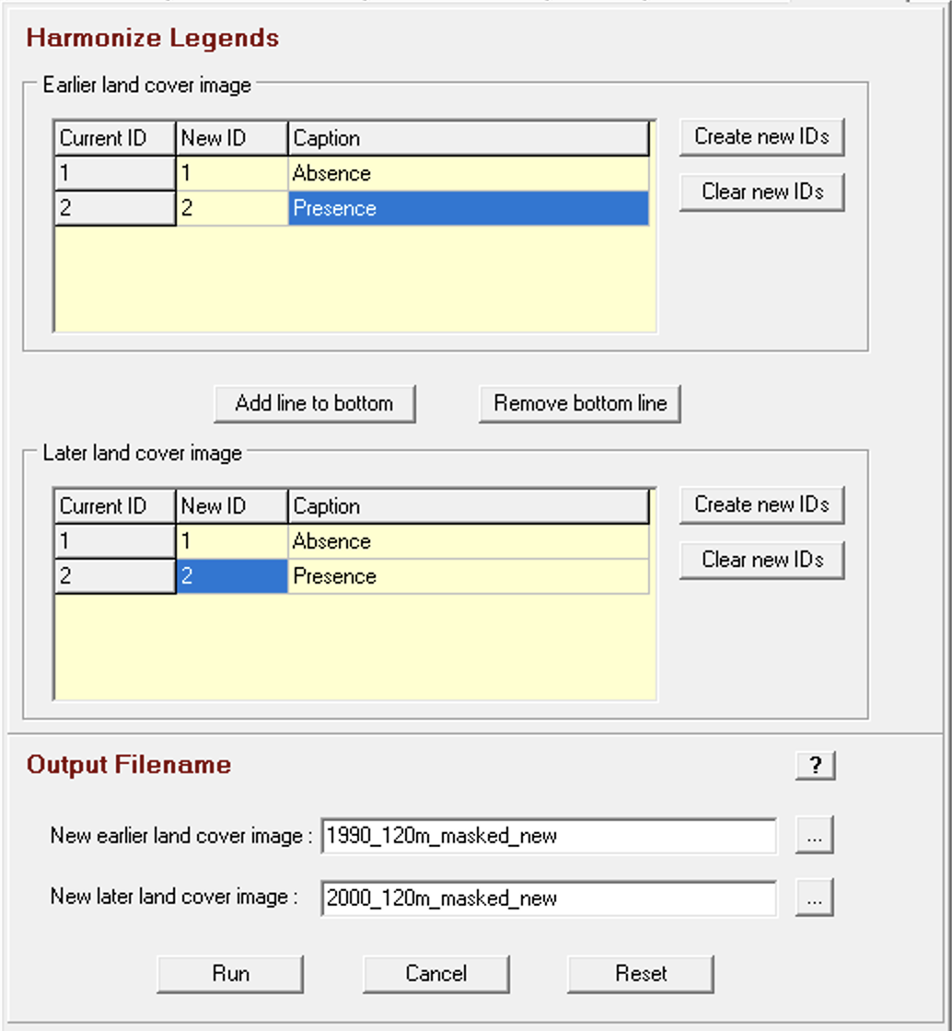
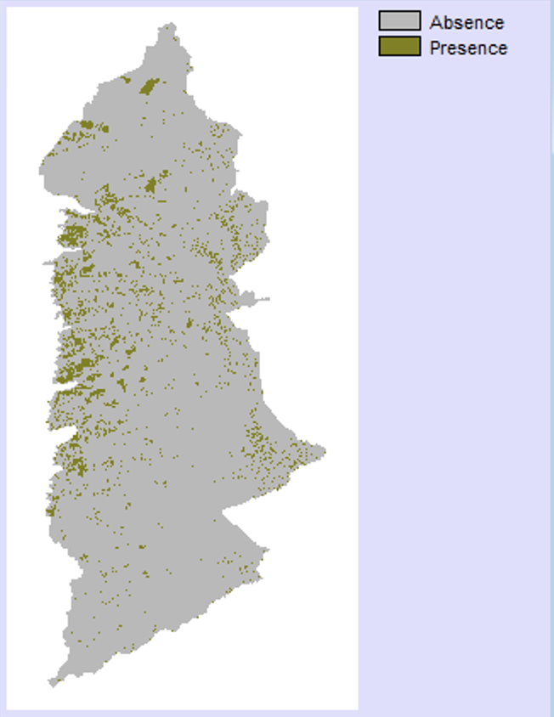
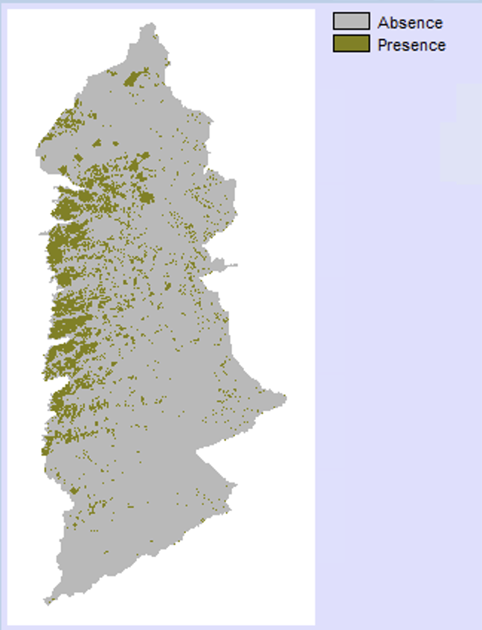
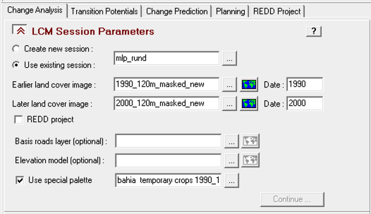
Data and Preparation- Harmonize Legends of 1990 and 2000 land cover image
We used the 1990 and 2000 land cover images for calibration. After harmonizing the legends of the cover images, we designated 1990 as the earlier land cover image and 2000 as the later land cover image under the LCM session parameters section.
Figure 3. 1990 land cover image with new legend
Figure 4. 2000 land cover image with new legend

Slide 7
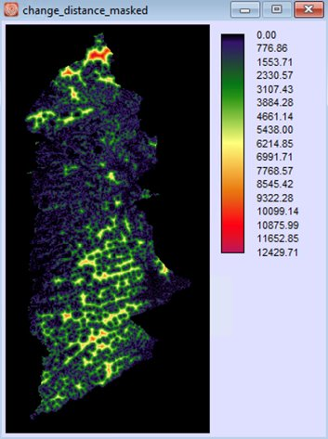
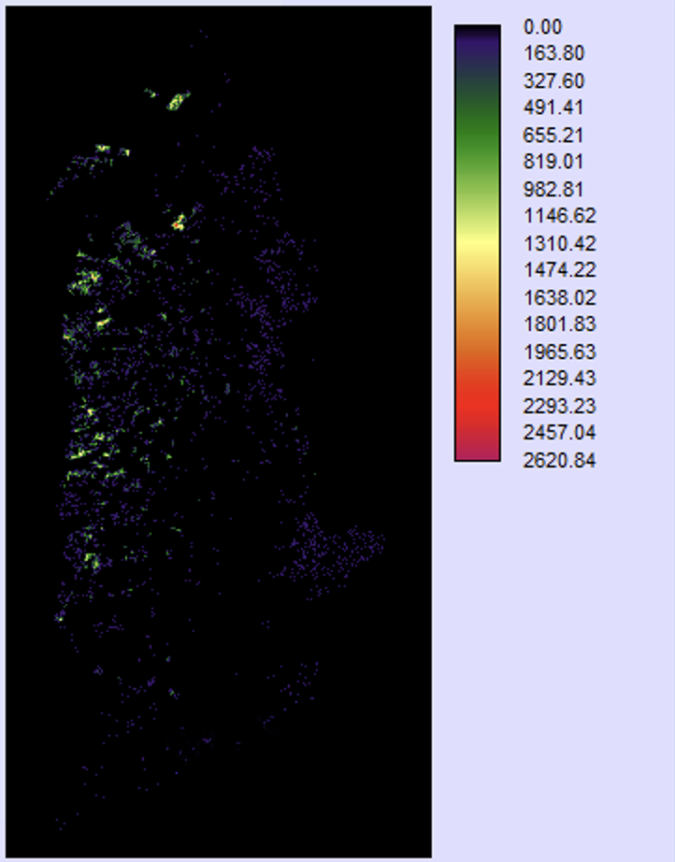
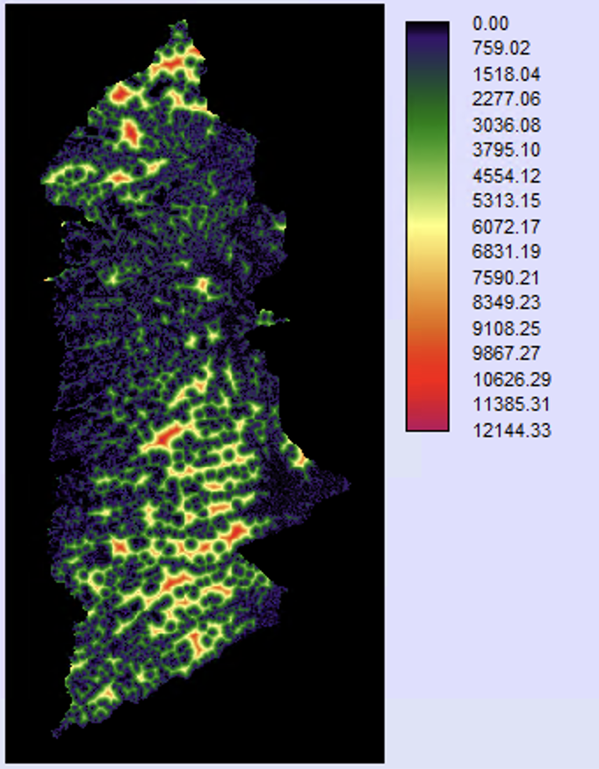
Data and Preparation - Variables: Distance to change, Distance to Absence, Distance Presence
Figure 5. Masked Distance to Change
Figure 6. Masked Distance to Absence
Figure 7.Maskekd Distance to Presence

Slide 8
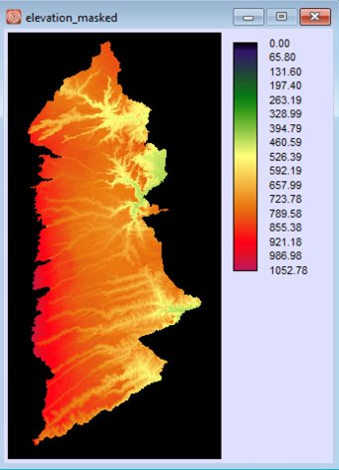
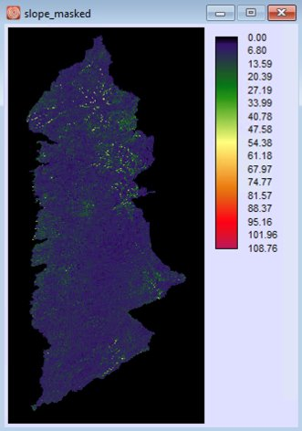
Data and Preparation- Variables: Slope and Elevation
The raster files of the raw and masked input images are available in the folder sent with these slides.
Figure 8. Masked Elevation
Figure 9. Masked Slope

Slide 9
Run A
Sub-model: Logistic Regression (LR)
Variable(s): distance to change (dynamic)

Slide 10
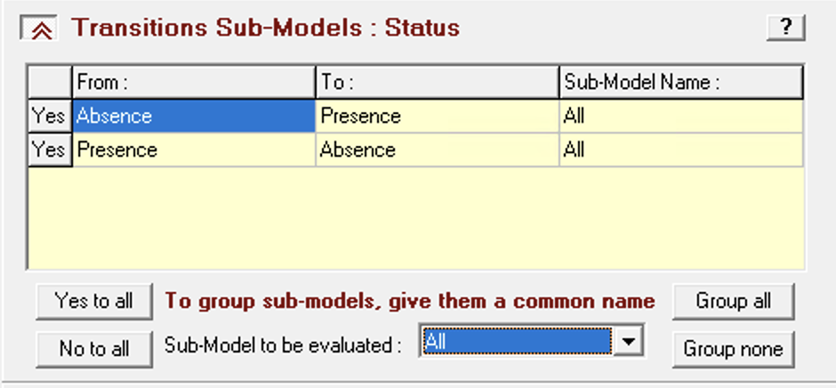
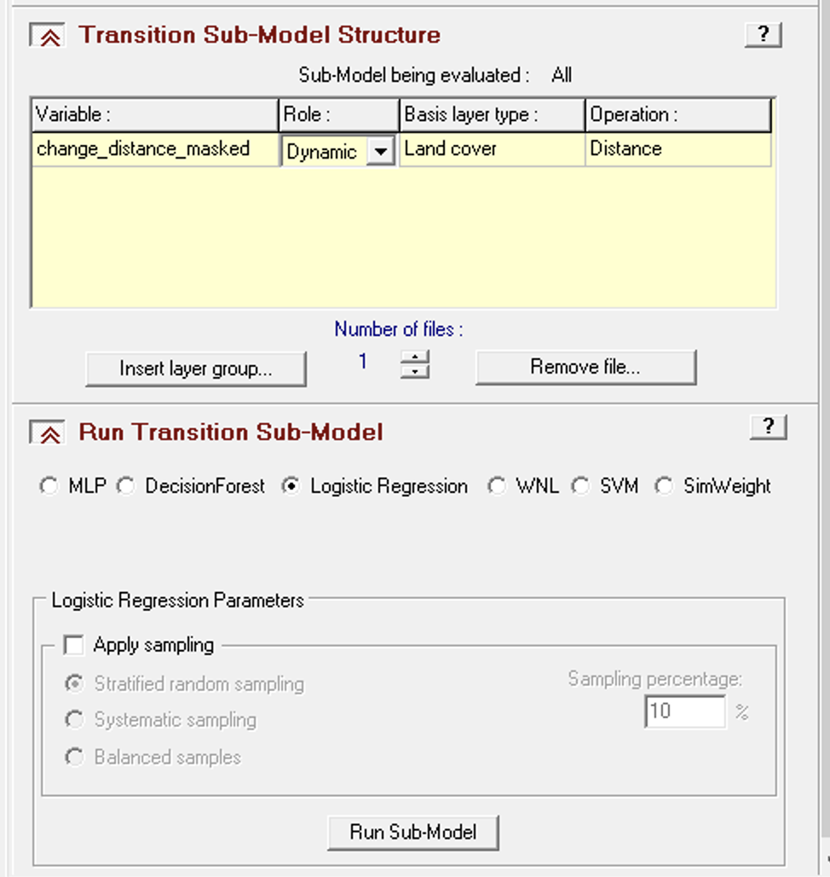
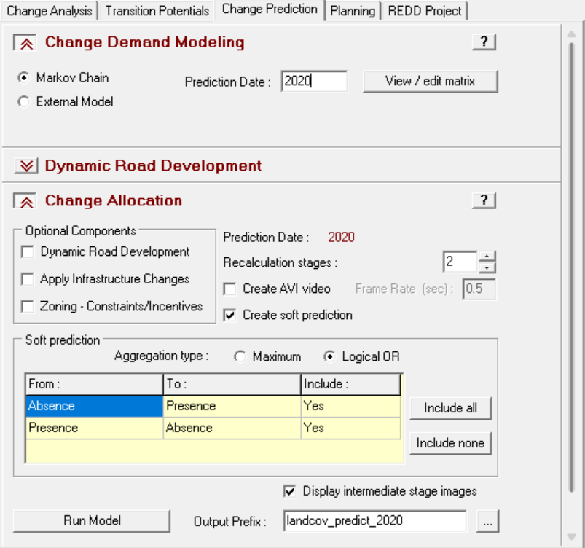
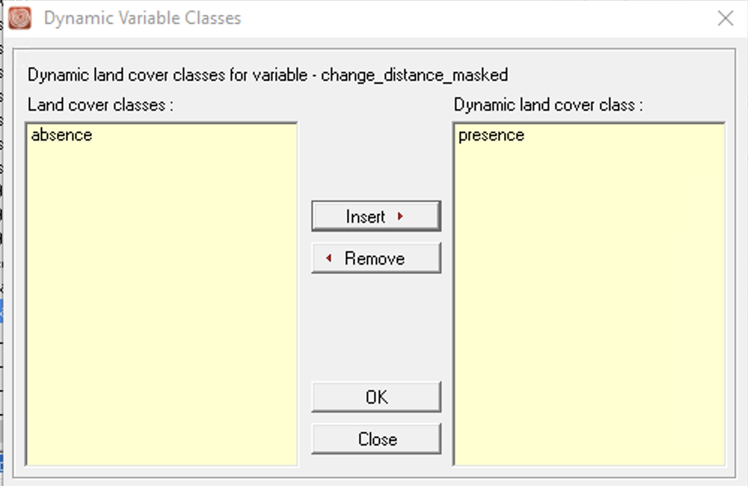
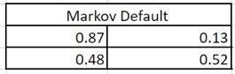
Methodology – Run A
In the Transitions Sub-Model Status select Group all.
2. Add Distance to Change as Dynamic Variable, choose Land Cover for the Basis layer type, and in the Dynamic Variable insert Presence.
3. Prediction Date: 2020, using default Markov, and use 2 Recalculation stages and check Create soft prediction

Slide 11
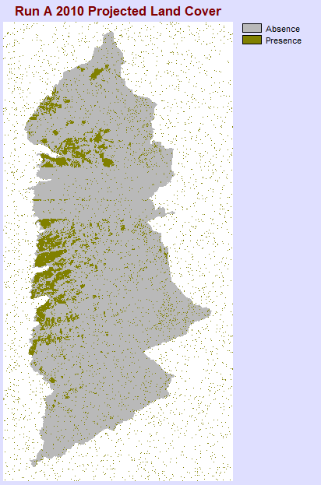
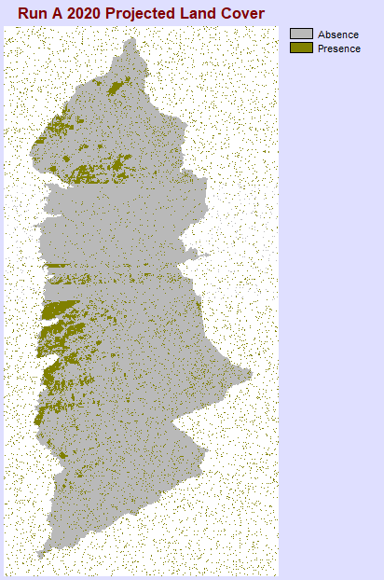
Prediction Results – Run A (Striping Issue and prediction the outside study area)
We initially ran logistic regression in LCM with only one variable: Distance to change (DTC) as dynamic variable. The predicted landcover maps for both stages resulted in striping (red ovals) and prediction outside the study area.
In an email with Professor Pontius, he explained that the issue was caused by "the number of pixels of simulated change [being] fewer than the number of pixels that have the same transition potential value" and recommended that we add more variables.
This led us to use additional variables, distance to absence , distance to presence, elevation and slope, to our next runs.
Figure 10. Run A prediction result 2010 (Stage 1)
Figure 11. Run A prediction result 2020

Slide 12
Run B
Sub-model: Logistic Regression (LR)
Variable(s): distance to absence (dynamic), distance to presence (dynamic),

Slide 13
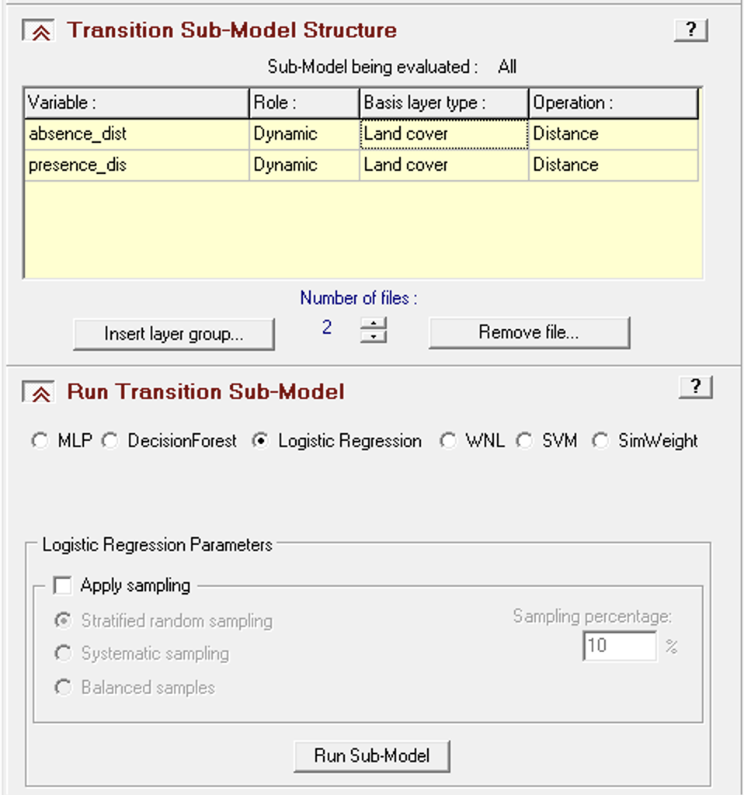
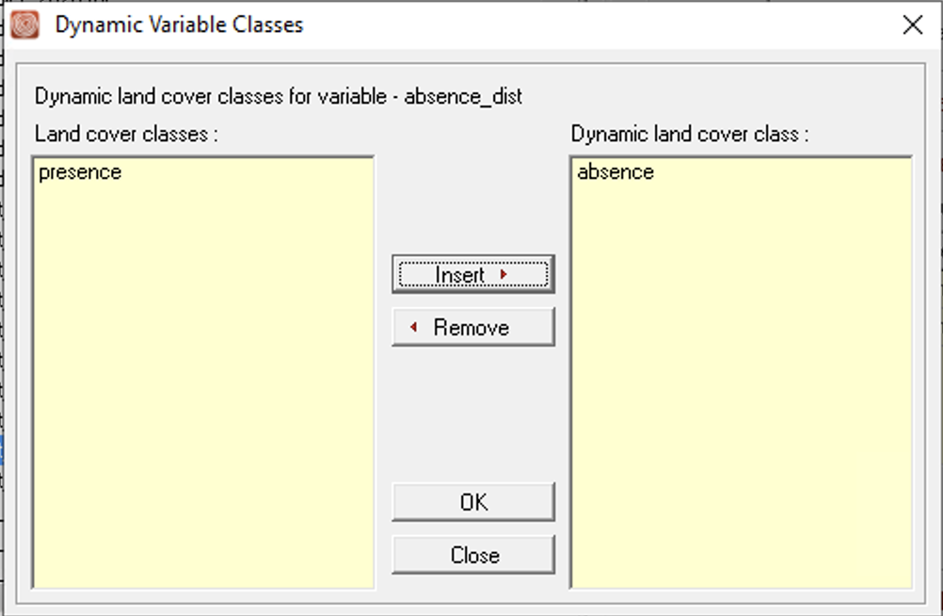
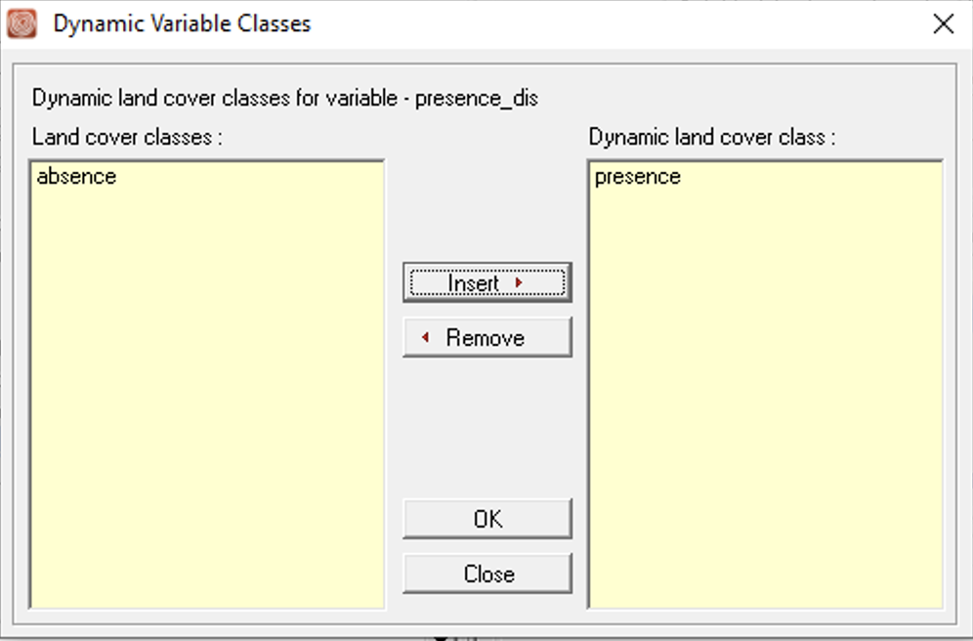
Methodology – Run B
In the Transitions Sub-Model Status select Group all
2. Add 'Change to Absence' and 'Change to Presence' as dynamic variables. Select 'Land Cover' as the basis layer type. In the dynamic variable settings, input 'Absence' for 'distance to absence' and 'Presence' for 'distance to presence'.
3. Prediction Date: 2020, using default Markov, and use 2 Recalculation stages and check Create soft prediction

Slide 14
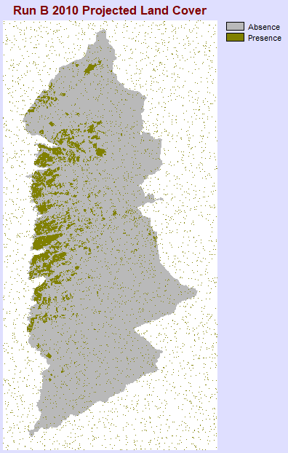
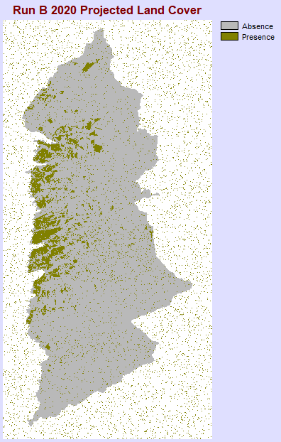
Prediction Results -Run B (prediction outside the study area)
In this run, we used variables: distance to absence and distance to presence as dynamic. The results exhibited no striping issues compared to Run A, however there was still predictions outside the study area.
Subsequently, we added additional variables, specifically Slope and elevation (although these were not included in the report). Despite this addition, the issue persisted. Therefore, in the next run, we added zoning to constrain the predictions within the study area.
Figure 12. Run B prediction result 2010 (Stage 1)
Figure 13. Run B prediction result 2020

Slide 15
Run C
Sub-model: Logistic Regression (LR)
Variable(s): distance to change (dynamic), elevation (static), slope (static)
With zoning

Slide 16
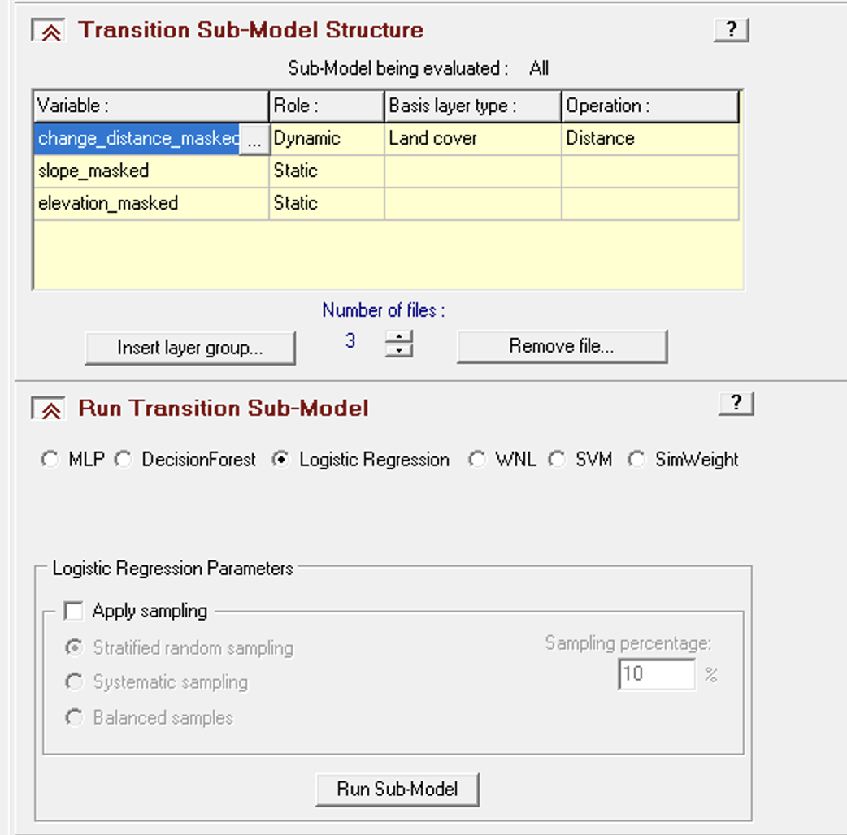
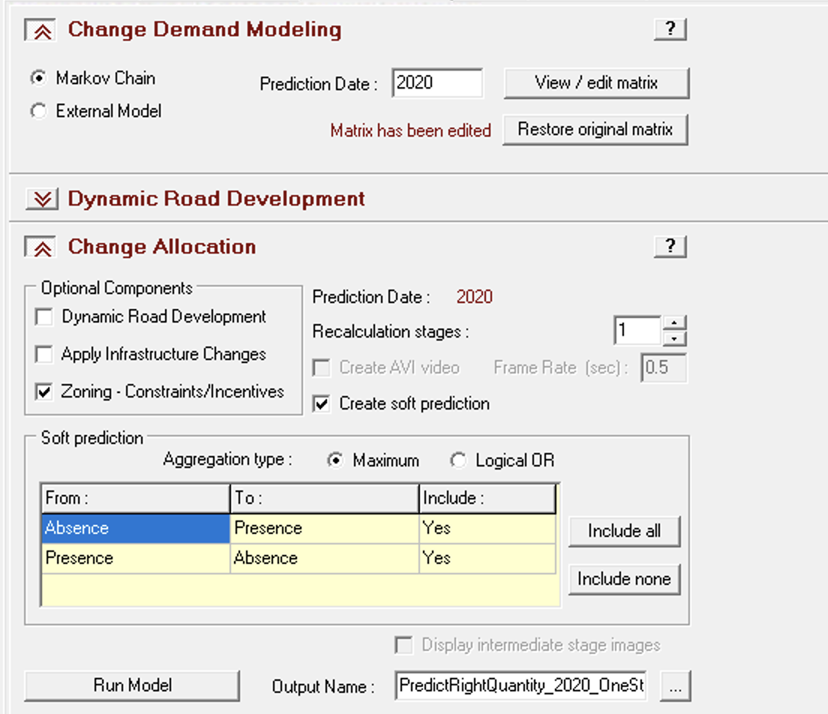
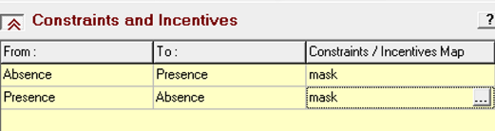
Methodology-Run C
1. In the Transitions Sub-Model Status select Group all
3. Prediction Date: 2020, using default Markov, and use 2 Recalculation stages, in the optional components, select Zoning- Constraints/Incentives
2. Add 'Change to Distance' as dynamic variables. Select 'Land Cover' as the basis layer type. In the dynamic variable settings, insert 'Presence'. Use 'Slope' and 'Elevation' as Static
4. Use 'mask' as constrains

Slide 17
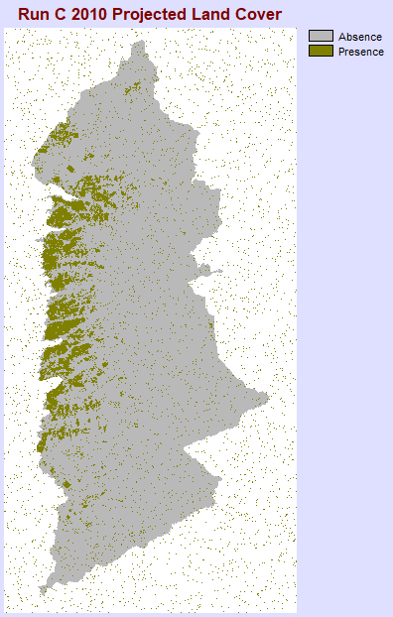
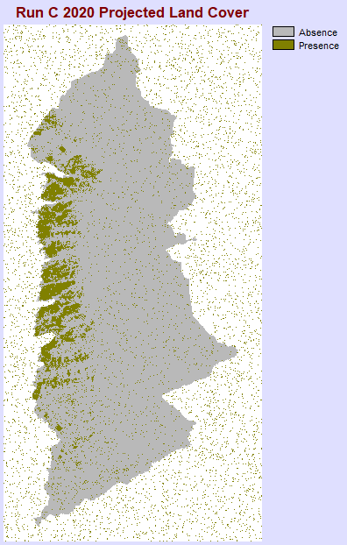
Prediction Results- Run C (prediction out of study area after adding constraint)
In this run, we used the mask as a constraint and incentive. However, the results in figures 14 and 15, still had change allocated outside of the study area.
Due to the extraction prediction issues from the Logistic Regression algorithm, we opted to utilize the MLP sub-model in subsequent runs.
Figure 14. Run C prediction result 2010 (Stage 1)
Figure 15. Run C prediction result 2020

Slide 18
Run D
Sub-model: Multilayer Perceptron (MLP)
Variable(s): distance to change (dynamic)

Slide 19
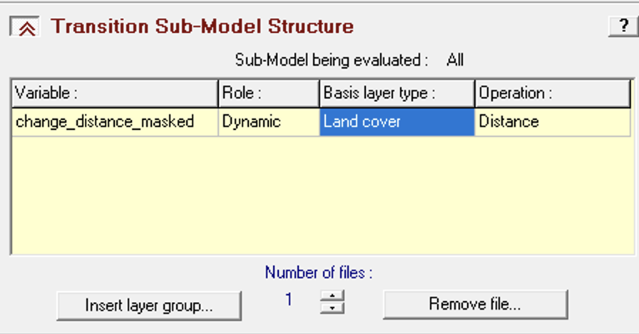
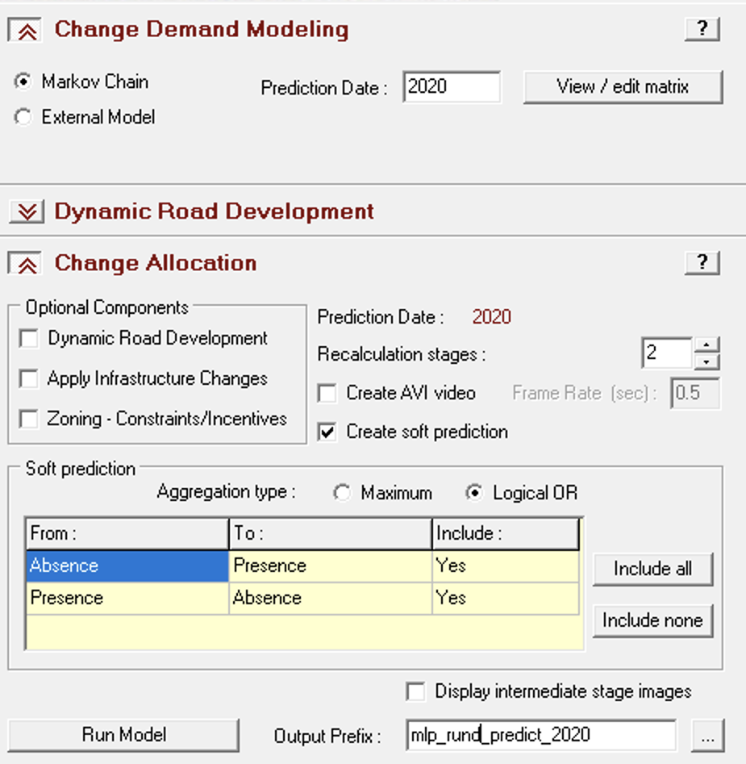
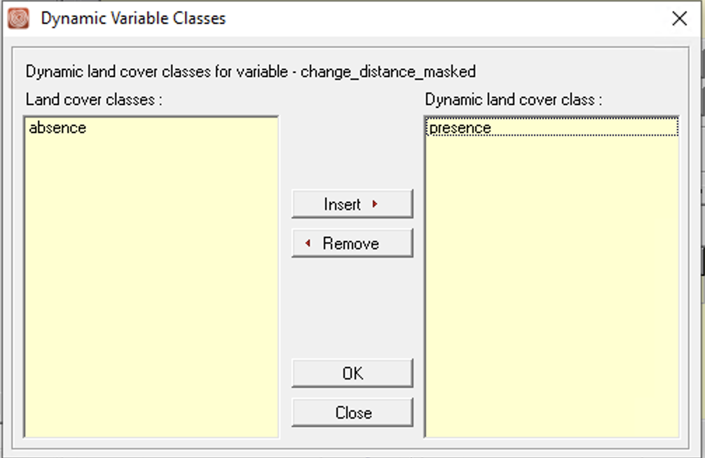
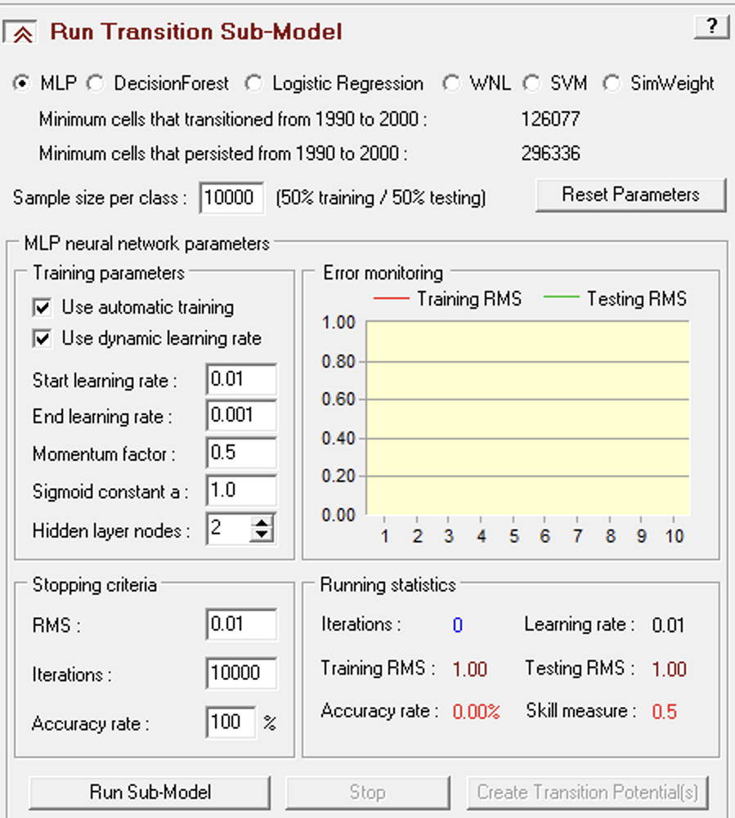
Methodology -Run D
In the Transitions Sub-Model Status select Group all
2. Add Distance to Change as Dynamic Variable, choose Land Cover for the Basis layer type, and in the Dynamic Variable insert Presence
3. Prediction Date: 2020, using default Markov, and use 2 Recalculation stages

Slide 20
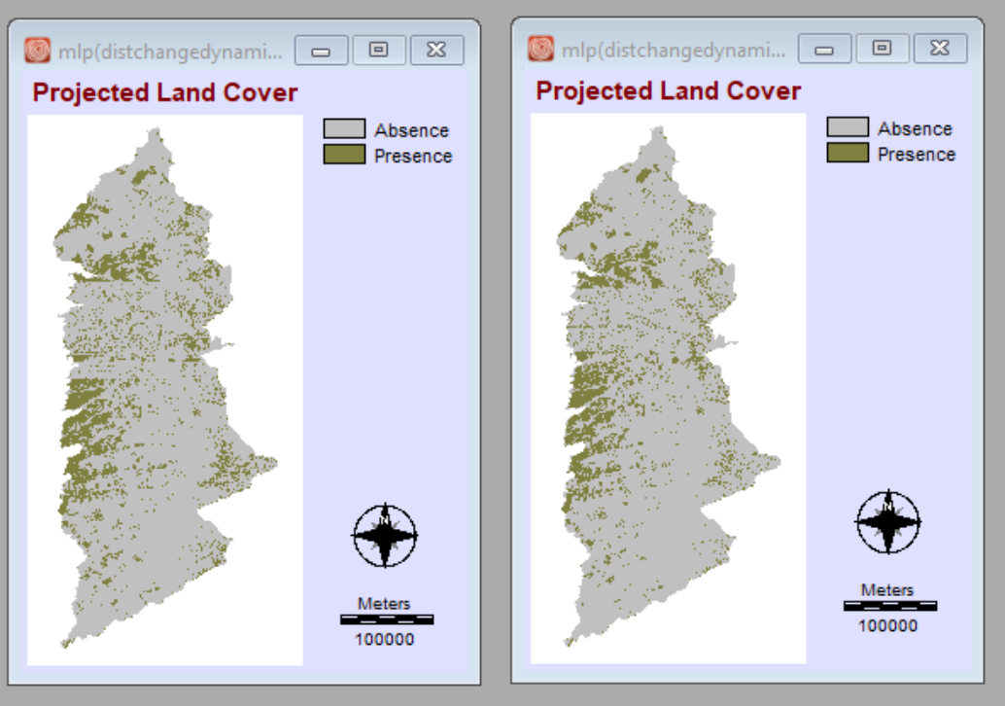
Prediction Results – Run D (Striping Issue)
We used 'distance to change' as the dynamic variable in this run. Additionally, we subjected the results to a three-way crosstab (2000 landcover image, 2010 simulation, 2020 simulation) to assess the simulation of alterations within the study area.
The results are the only MLP result we attempted that encompasses all eight trajectory categories and shows alternations. Nevertheless, some slight striping is still observable in the figures.
Figure 15. Run D prediction result 2010 (Stage 1)
Figure 16. Run D prediction result 2020

Slide 21
Run E
Sub-model: Multilayer Perceptron (MLP)
Variable(s): distance to change (static), distance to presence (dynamic), distance to absence (dynamic)

Slide 22
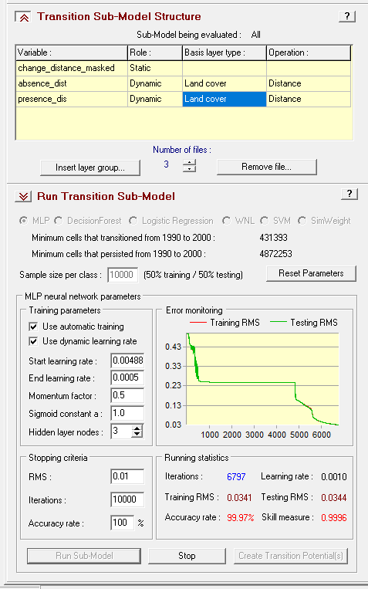
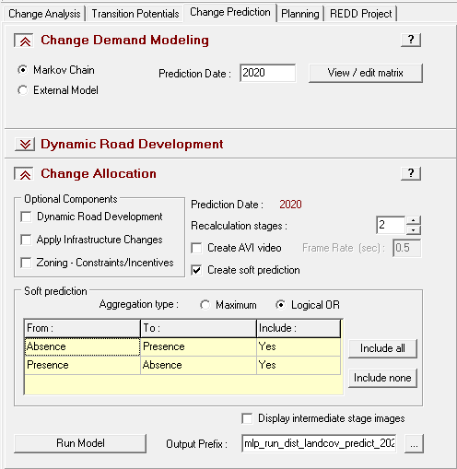
Methodology - Run E
In the Transitions Sub-Model Status select Group all
3. Prediction Date: 2020, using default Markov, and use 2 Recalculation stages
2. Add 'Change to Absence' and 'Change to Presence' as dynamic variables. Select 'Land Cover' as the basis layer type. In the dynamic variable settings, input 'Absence' for 'distance to absence' and 'Presence' for 'distance to presence'. And add 'Distance to Change' as static

Slide 23
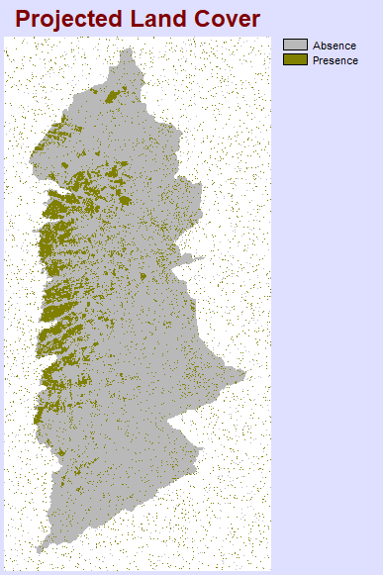
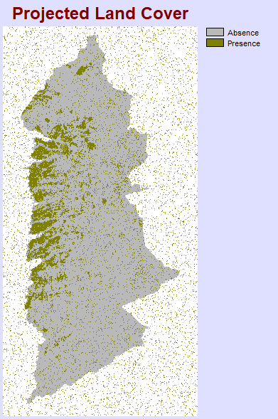
Results -Run E (Earlier Attempt) (prediction out of study area)
We added two more variables in this run: 'Distance to Absence' and 'Distance to Presence' as dynamic factors. The striping issue was successfully resolved. However, in our earlier runs, we encountered a problem in allocating change data outside the study area.
Despite repeated attempts to rerun the model, the problem persisted. Surprisingly, while working on the final product we rerun with the same parameters and variables. But the issue was ultimately resolved, as shown in the next slide.
Figure 17. Run E prediction result 2010 (Stage 1) with issue
Figure 18. Run E prediction result 2020 with issue

Slide 24
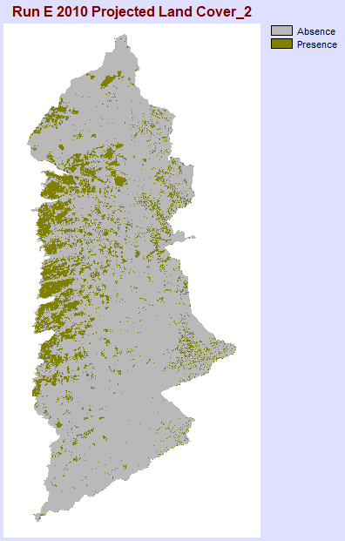
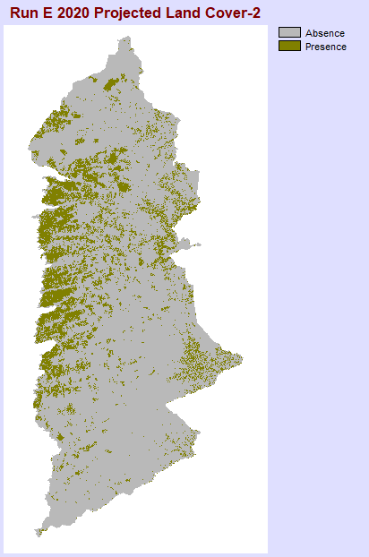
Results --Run E (Later Attempt)(Instability in Prediction Results)
In later runs, we maintained the same variables and parameters yet encountered results free from issues. This problem of pixel allocation outside the study area persisted across multiple runs before, as evidenced in the previous slide.
What's intriguing is that we encountered similar problems in some of the MLP runs, but when we restarted Terrset, the issue was resolved. We attempted several times for this run and tried on a different computer, but the problem persisted, and this time, the issue of pixel allocation outside the study area did not reoccur. However, we stumbled upon another problem - the results show instability in their predictions. This issue was not unique to this run, as we encountered it in other runs as well, as shown in the following slides.
Figure 19. New Run E prediction result 2010 (Stage 1)
Figure 20. New Run E prediction result 2020

Slide 25
Additional Runs Results

Slide 26
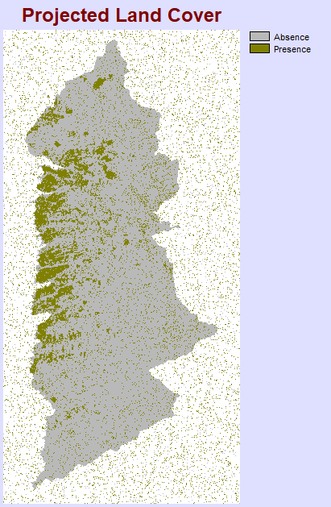
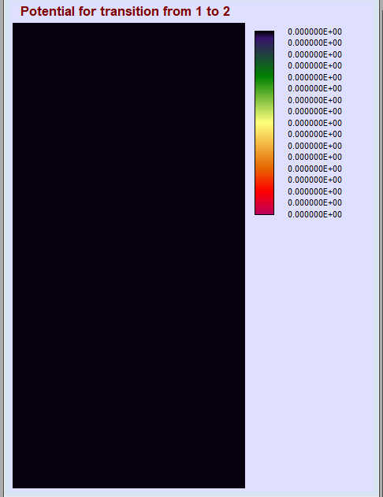
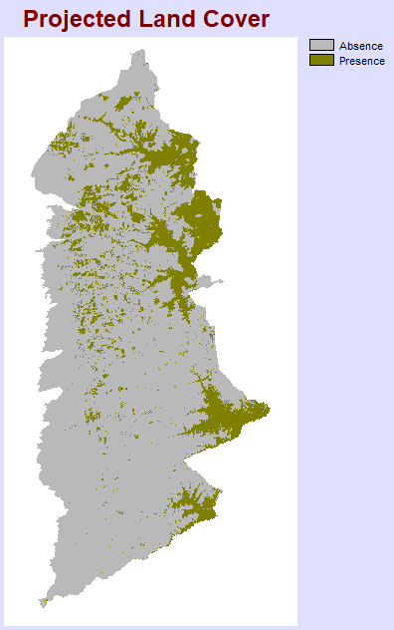
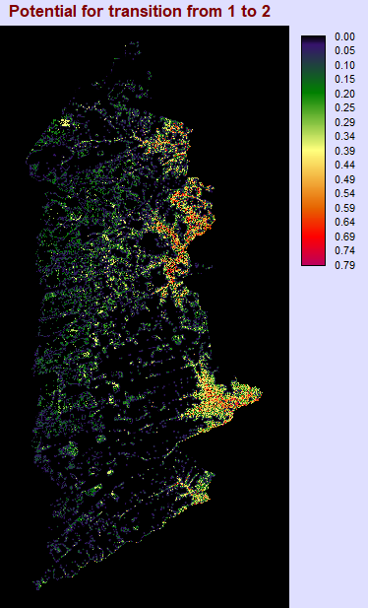
Unstable prediction Results - (DTC as Dynamic, Slope, Elevation)
Unexpected errors occurred when we tried different runs with the same variable in MLP. The result on the left we ran with DTC as Dynamic, Slope, and Elevation. The results got pixels allocation out of the study area; after we restarted TerrSest and ran again, the problem was solved.

Slide 27
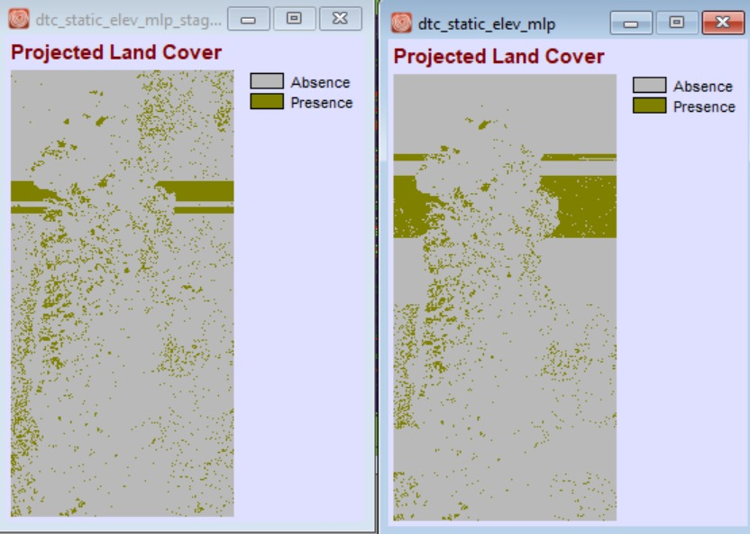
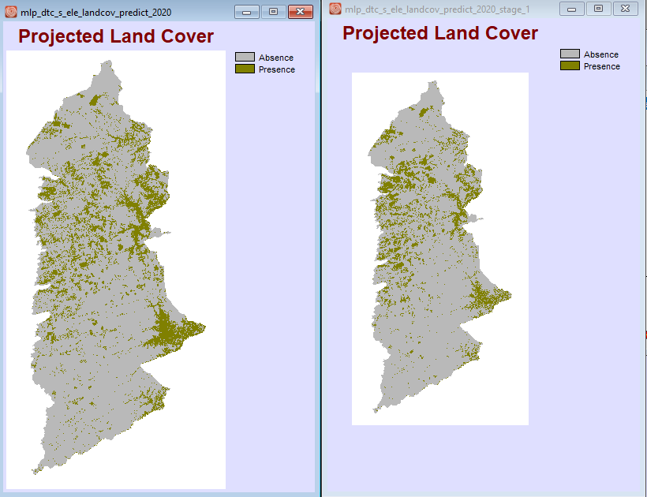
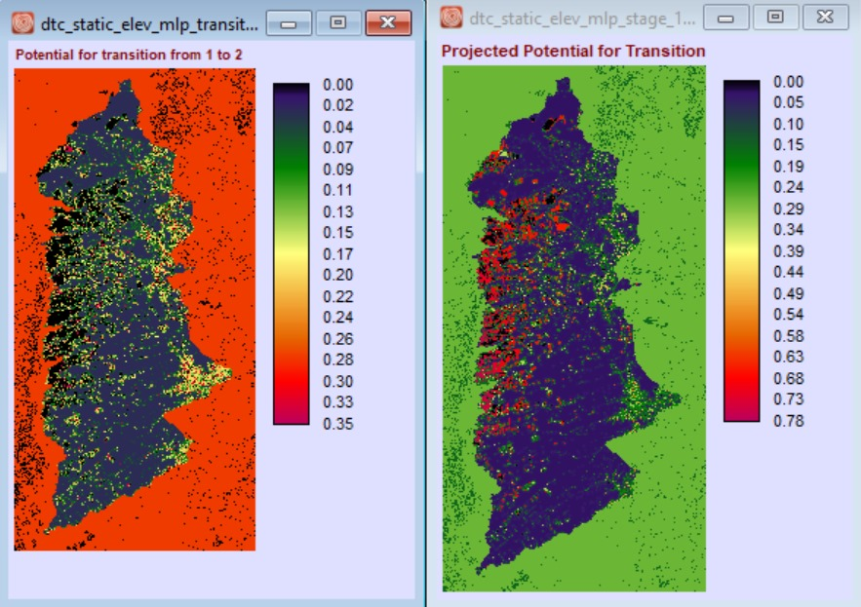
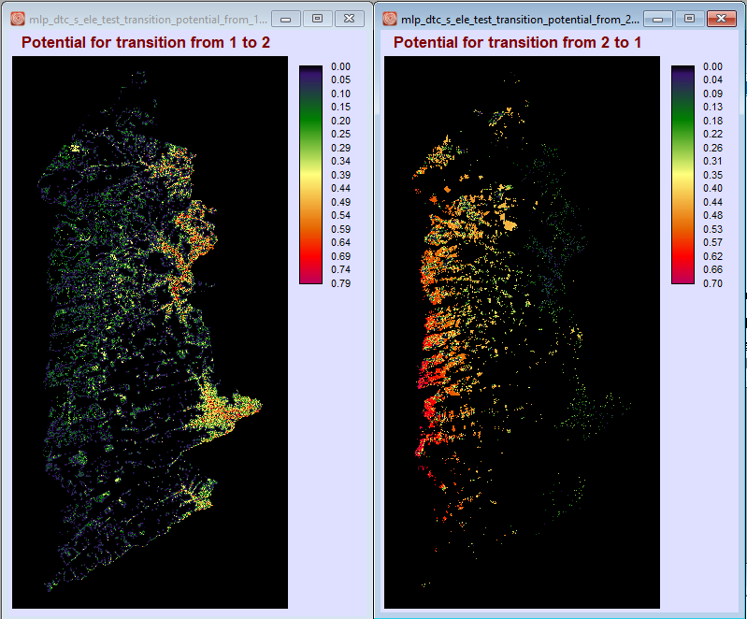
Unstable prediction Results - (DTC as Static, Elevation)
The result on the left we ran with DTC as static, Slope, and Elevation, the previous results got striping issue and pixels allocation out of the study area; after we restarted Terrest and ran again, the problem was solved.

Slide 28
Summary of Findings
The striping problem was attributed to the situation where "the number of pixels depicting simulated change was fewer than the number of pixels with the same transition potential value." by Professor Pontius. This issue was initially observed when using only a single distance variable, but it was effectively resolved after incorporating additional variables.
However, the Logistic Regression model encountered pixel allocation problems outside the study area. This issue persisted across various runs with different variables.
In the MLP results, we experimented with different variables, and although these results exhibited no pixel allocation problems, they tended to be less stable. The stable results also occasionally experienced allocation issues, but notably, most of these problems were resolved after restarting Terrset.

